Slide 1
MODULE - 5
Global Concerns :Global warming, Climate change, Acid rain, Ozone depletion .
Field work: Visit to Environmental Engg. Lab, Zero Waste Management Plant and Solid waste management plant
Self-Study Component (SSC): Case studies of global warming
VVCE

Slide 2

The term was first coined by ROBERT ANGUS SMITH in the year 1852.
"Acid rain" is a popular term referring to the deposition of a mixture from wet (rain, snow, sleet, fog, cloudwater, and dew) and dry (acidifying particles and gases) acidic components.
The major contributors, to the acid rain are
Sulphur dioxide and
Nitrogen oxides
VVCE

Slide 3
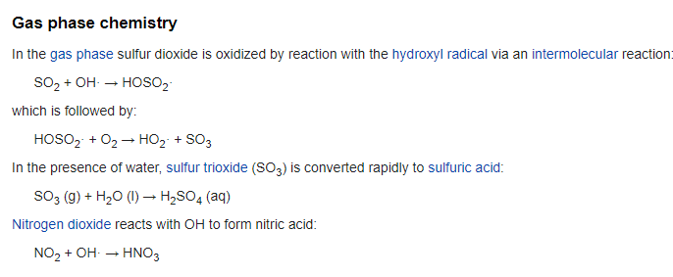
This radical then reacts with nitric oxide to give nitrous acid and nitrogen dioxide to give nitric acid.
It also combines with Sulphur dioxide to produce Sulphuric acid.
VVCE

Slide 4
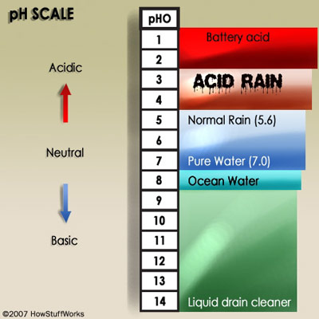
VVCE

Slide 5
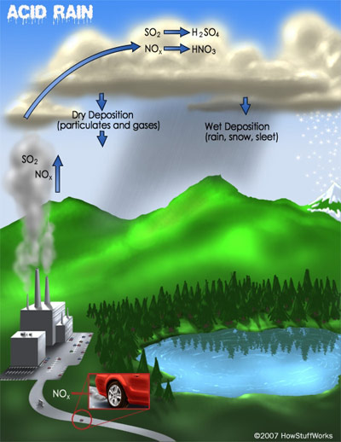
VVCE

Slide 6
Acid rain or acid deposition has an adverse effect on environmental ecosystem as well as humans, animals, buildings, Industries.etc.
Acid rain dissolves in Soil and washes away nutrients needed by the plants
Removal of useful nutrients from the soil, acid rain slows the growth of plants, particularly trees.
VVCE

Slide 7
Due to this the water life is destroyed.
Rain and dry deposition of acidic particles damage building, automobiles, and other structures made of stone metal or any other material exposed to weather . Ex:Taj- Mahal in India, are deteriorating due to acid deposition.
Acidification of Surface water cause direct harm to human health
VVCE

Slide 8
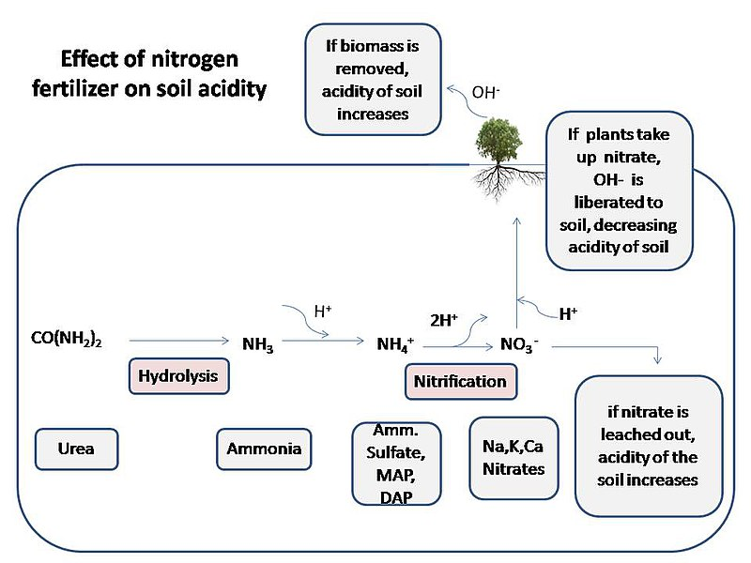
Effects of Acid rain
Surface waters and aquatic animals
Ocean acidification
Forests and other vegetation
Soil acidification
VVCE

Slide 9
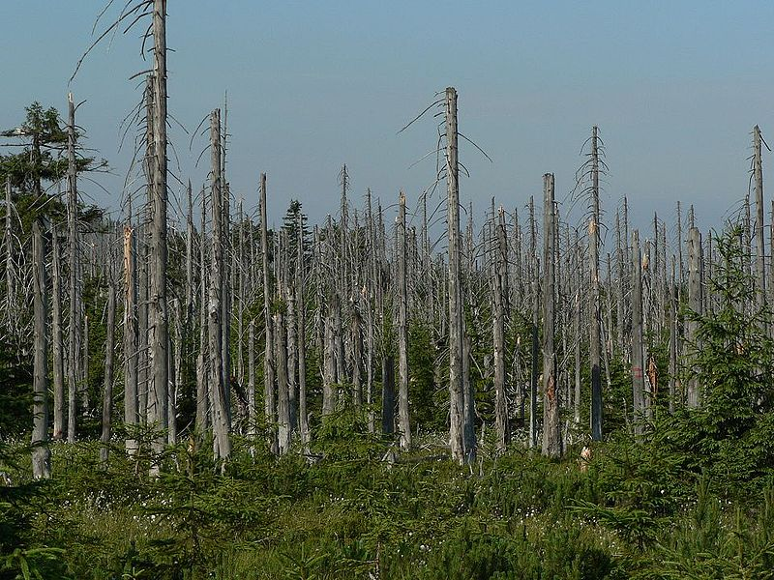
Even trees in well-buffered soil can weaken in harsh acid fog. High-elevation forests soak in acidic clouds, which strip leaves of nutrients and break down trees' ability to resist cold. The bald peaks of the Appalachian Mountains tell of the poisonous effect of acid rain on high-elevation forests.
VVCE

Slide 10
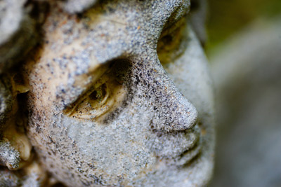
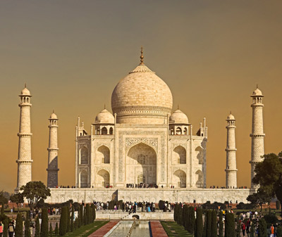
Materials and Finishes
Acid rain has the unsettling ability to erase and obliterate stone and metal, the most durable of materials. Old buildings, monuments and tombstones bear the smooth signs of acidic corrosion and deterioration. Acid deposition speeds up natural weathering caused by rain, sun, snow and wind.
VVCE

Slide 11
OZONE LAYER DEPLECTION
VVCE

Slide 12
Ozone layer was discovered by a French physicists CHARLES FABRY and HENRI BUISSON in 1913
Its properties were explored in detail by G.M.B.DOBSON, a British Meteorologist
Dobson established a worldwide network of ozone monitoring stations which operate even today
The total amount of Ozone in a column overhead is measured in “DOBSON Unit” (DU), 1DU=0.01mm
VVCE

Slide 13
Ozone layer in a region of the atmosphere varies from 19 to 48 km above the earth’s surface
UV radiation is divided into three categories based on its wave length, ie.,
UV-A, (315 to 400nm)
UV-B, (280 to 315nm)
UV-C. < 280nm
VVCE

Slide 14
Ozone is formed in the Stratosphere when oxygen molecules dissociate after absorbing the ultraviolet photon whose wave length is shorter than 240nm
This produces two oxygen atoms. The atomic oxygen( Nascent oxygen) then combines with O₂ to create ozone O₃
The process O₃ formation and splitting is cyclic in nature
VVCE

Slide 15
Cause of Ozone depletion
Ozone can be destroyed by a number of free radical catalyst, like hydroxyl (OH), the nitric oxide (NO), atomic chlorine (Cl) and Bromine (Br)
These elements are found in certain stable organic compounds, particularly chlorofluorocarbons (CFC’s)
VVCE

Slide 16
In 1994 UN General, assembly voted to designate September 16 as “World Ozone day”
The thickness of the ozone layer over Europe which has decreased by 8% since the 1980’s has now slowed down to about 4% a decade
VVCE

Slide 17
Global warming
It is the increase in average temperature of the earth’s near surface air and oceans
Most of the observed temperature increase is caused by increased concentration of greenhouse gases
Major gases: water vapor – 36-70% carbon dioxide- 9 – 26 % methane - 4- 9 % ozone -3–7%
VVCE

Slide 18
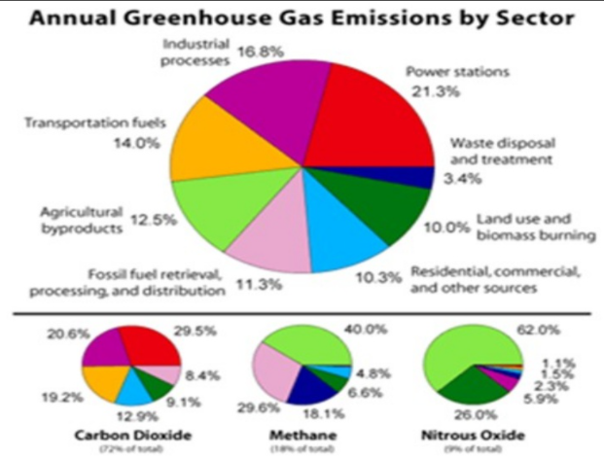

VVCE

Slide 19
Global Warming Potential(GWP)
GWP of a greenhouse gas is its ability to trap extra heat in the atmosphere over time relative to carbon dioxide (CO₂). This is most often calculated over 100 years, and is known as the 100 year GWP
GWP is 1 for CO2. For other gases it depends on the gas and the time frame
VVCE

Slide 20
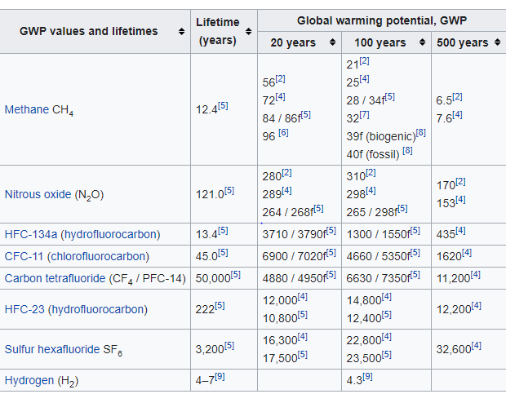
VVCE
Source: https://en.wikipedia.org/wiki/Global_warming_potential

Slide 21
IPCC
The Intergovernmental Panel on Climate Change (IPCC) is an intergovernmental body of the United Nations that is dedicated to providing the world with objective, scientific information relevant to understanding the scientific basis of the risk of human-induced climate change, its natural, political, and economic impacts and risks, and possible response options
The IPCC was established in 1988 by the World Meteorological Organization (WMO) and the United Nations Environment Programme (UNEP) and was later endorsed by the United Nations General Assembly
VVCE

Slide 22
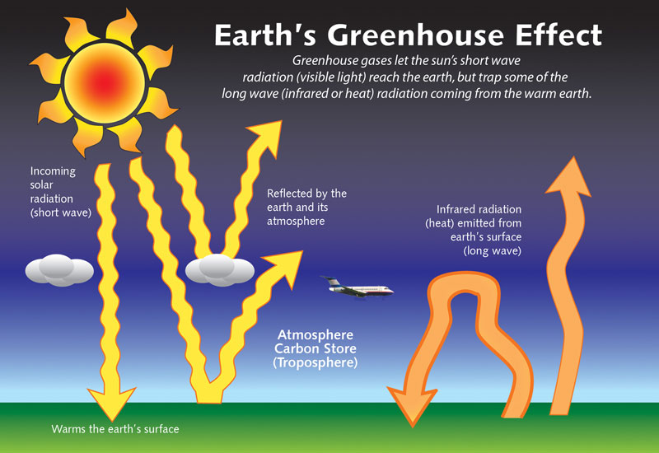
VVCE

Slide 23
Sources of GHG
Greenhouse gas | Natural source | Man-made source
Methane | Decomposing plant material | Rice paddy fields, cattle, coal mines
Water vapour | Evaporation from oceans, lakes and rivers | Burning hydrocarbon fuels
Carbon dioxide | Respiration by plants and animals,forest fires, volcanoes | Making cement, burning fossil fuels
VVCE

Slide 24
Other effects of Global warming
Melting glaciers, early snowmelt, and severe droughts will cause more dramatic water shortages and increase the risk of wildfires
Rising sea levels will lead to coastal flooding
Forests, farms, and cities will face troublesome new pests, heat waves, heavy downpours, and increased flooding. All those factors will damage or destroy agriculture and fisheries.
VVCE

Slide 25
Contd.,
Disruption of habitats such as coral reefs and Alpine meadows could drive many plant and animal species to extinction.
Allergies, asthma, and infectious disease outbreaks will become more common due to increased growth of pollen-producing ragweed, higher levels of air pollution, and the spread of conditions favorable to pathogens and mosquitoes.
VVCE

Slide 26
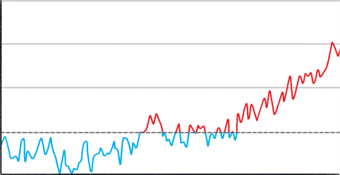
What Is Climate Change?
Climate change is a change in the average temperature and cycles of weather over a long period of time.
Since 1880, scientists have kept thermometer-based records of the global surface temperature.
What is happening to the global temperature?
The planet is becoming warmer; the climate is changing.
1.5
1.0
0.5
Temperature Anomaly (°C)
Data source: NASA's Goddard Institute for Space Studies (GISS)
0
-0.5
1880
1888
1896
1904
1912
1920
1928
1936
1944
1952
1960
1968
1976
1984
1992
2000
2008
2016
Year

Slide 27
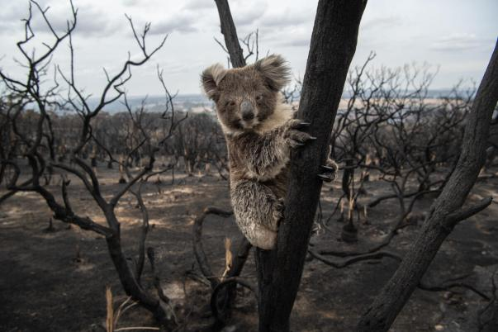
Why Is Climate Change a Problem?
Over millions of years, species become adapted to survive in the conditions in which they live. A stable climate supports this process and allows living things to thrive. If the climate changes quickly, organisms don’t have enough time to adapt to new conditions and may no longer be able to survive.
Bushfire Aftermath On Kangaroo Island by © Brad Fleet / Newspix licensed under CC BY

Slide 28
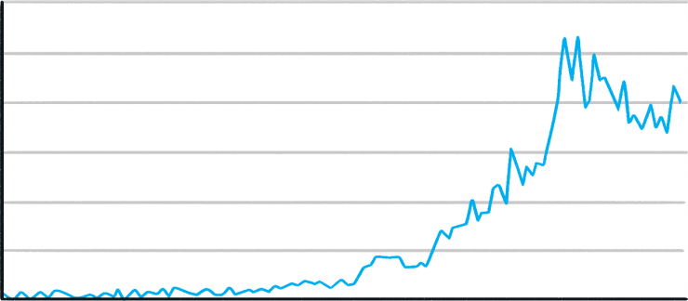
Why Is Climate Change a Problem?
Climate change disrupts weather patterns and causes extreme weather events to become more common. These include hurricane activity, droughts and floods.
As the global temperature has increased, so has the number of reported natural disasters.
600
500
400
Number of Reported Natural Disasters
Data source: EM-DAT International Disaster Database
300
200
100
0
1900
1920
1940
1960
1980
2000
2020
Year

Slide 29
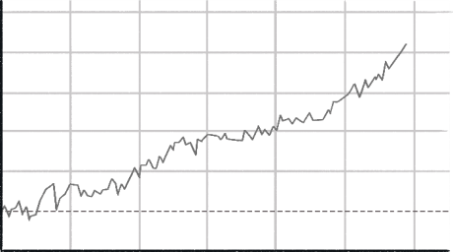
Why Is Climate Change a Problem?
Rising temperatures are causing sea levels to increase.
The rising water can cover coastal areas, destroying habitats and displacing whole populations from low-lying areas.
250
200
150
Sea Level Change (mm)
100
Data source: NASA (GISS)
50
0
-50
1900
1920
1940
1960
1980
2000
2020
Year
Rising sea levels are driven by two main processes:
Ice Melt: When the atmosphere and ocean get warmer, ice sheets and glaciers melt, resulting in the addition of fresh water to the ocean.
Thermal Expansion: As ocean water gets warmer, it expands, causing
sea levels to rise.

Slide 30
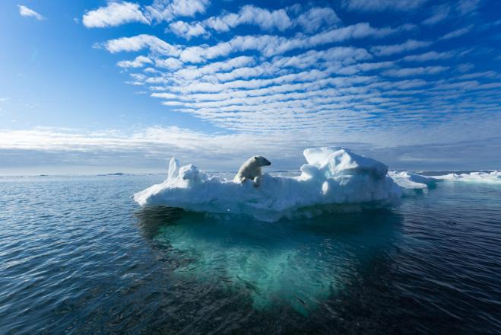
Why Is Climate Change a Problem?
The increase in global temperatures is causing a reduction in sea ice.
This causes problems for animals that depend on the ice to hunt, mate and sleep.
Untitled by © Shutterstock / Ritesh Chaudhary / WWF licensed under CC BY

Slide 31
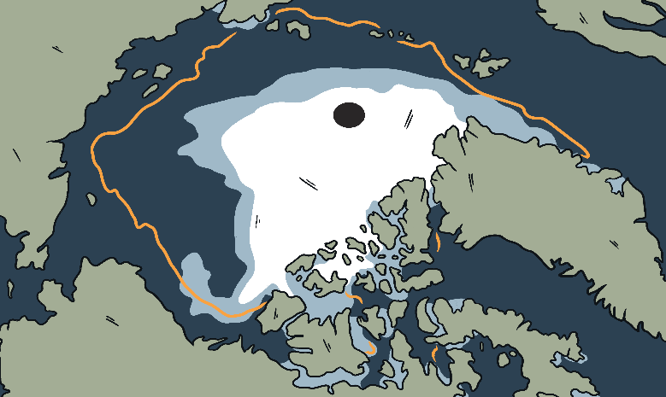
Why Is Climate Change a Problem?
The bright surface of the ice reflects 80% of the sunlight that hits it back into space. This keeps the polar regions cool and moderates the global climate.
When the area of sea ice is reduced, less sunlight is reflected back into space. This causes more ocean warming and reduces the sea ice even further.
This feedback drives faster climate change.
The orange line on the picture marks the average minimum sea ice coverage from 1981 to 2010. The white ice shows the minimum sea ice coverage in 2020.
The difference between the two exceeds one million miles.
Russia
Greenland
Alaska

Slide 32
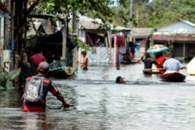
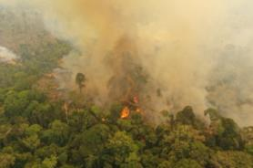
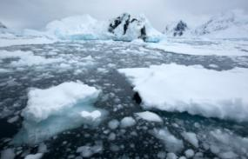
Why Is Climate Change a Problem?
No matter how fast we act, the global temperature is set to continue rising as a result of greenhouse gases that are already in the atmosphere. The problems that we are already experiencing are going to worsen.
Untitled by © Marcio James / WWF–Brazil licensed under CC BY
Untitled by © Marcio James / WWF–Brazil licensed under CC BY
Melting ice, Antarctica by © Wim van Passel / WWF licensed under CC BY
Acting quickly to keep the temperature rise to minimum is extremely important for humans and wildlife.
How much difference do you think a 0.5°C increase in global temperature can make?

Slide 33
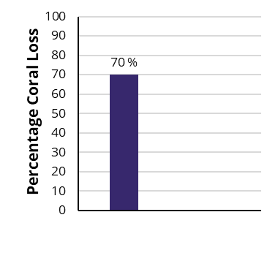
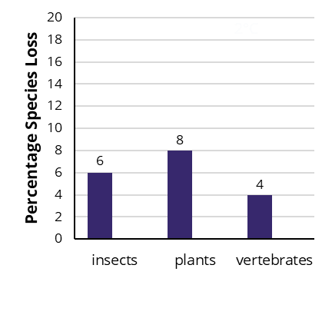
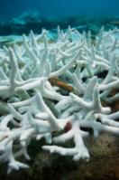
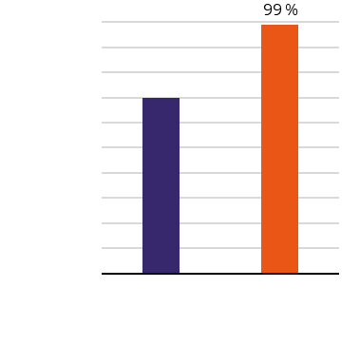
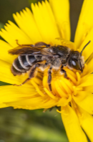
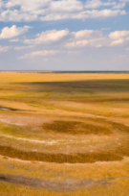
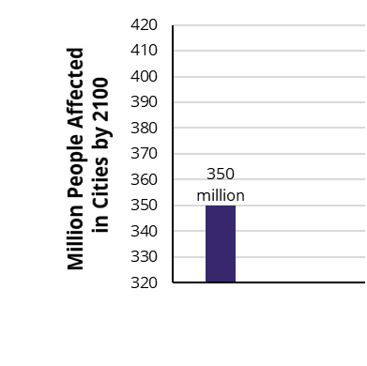
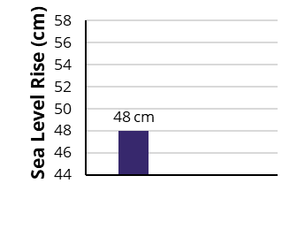
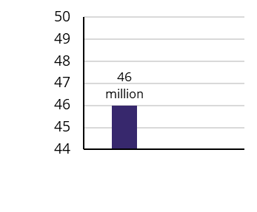

Why Is Climate Change a Problem?
Coral Bleaching
Species Loss
18
1.5°C
16
2°C
8
1.5
2
Temperature Rise (°C)
Bleached coral, Maldives by
© naturepl.com / Peter Scoones / WWF licensed under CC BY
Untitled by © Ola Jennersten
/ WWF-Sweden licensed under CC BY
Drought
Rise in Sea Level
410
million
56 cm
49
million
Million People Affected
1.5
2
1.5
2
Temperature Rise (°C)
Temperature Rise (°C)
1.5
2
Temperature Rise (°C)
Dried up fishing pans in Liuwa plain
National Park by © Jasper Doest / WWF licensed under CC BY
Climate change adaption Wadden sea by © Claudi Nir / WWF licensed under CC BY

Slide 34
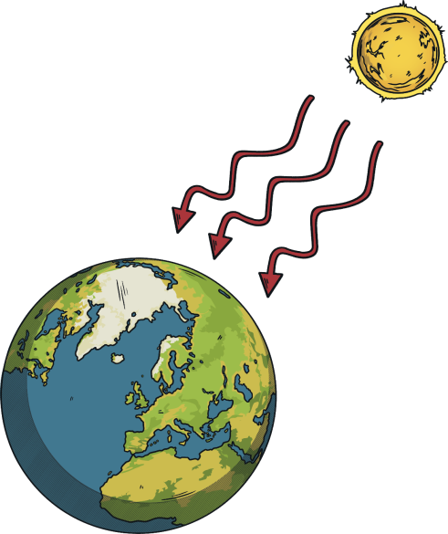
What Causes Climate Change?
Carbon dioxide (CO₂),
methane (CH₄) and water vapour (H₂O) are greenhouse gases that are found in the atmosphere.
Energy travels from the Sun
to the Earth as short wave radiation. It does not interact strongly with the greenhouse gas molecules so it reaches the Earth’s surface.
H₂O
CO₂
CH₄
CH₄
CO₂
CH₄
CO₂
H₂O
CH₄
CO₂

Slide 35
What Causes Climate Change?
The Earth’s surface emits
long wavelength radiation.
This does interact with the greenhouse gas molecules.
The greenhouse gas molecules absorb some of the energy, trapping it in the atmosphere.
This process keeps the Earth warm and is essential for life.
H₂O
CO₂
CH₄
CH₄
CO₂
CH₄
CO₂
H₂O
CH₄
CO₂

Slide 36
What Causes Climate Change?
The higher the proportion
of greenhouse gases in the atmosphere, the more radiation is absorbed.
This causes a rise in the temperature of the Earth and is known as the greenhouse effect.
This increase in temperature drives climate change.
CO₂
H₂O
CO₂
CO₂
CO₂
CO₂
CH₄
CH₄
CO₂
CH₄
CO₂
CO₂
CO₂
CO₂
CH₄
CH₄
CO₂
CO₂
CO₂
H₂O
CH₄
CO₂
CH₄
CO₂
CO₂
CO₂

Slide 37
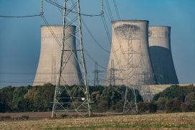
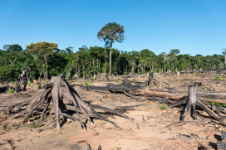
What Causes Climate Change?
Climate change can be caused gradually by natural processes or suddenly by large events, such as a massive meteorite strike or volcanic activity. However, the rapid climate change we are experiencing now is due to three main human activities:
Burning fossil fuels for heating and cooking, generating electricity and powering vehicles releases carbon dioxide into the atmosphere.
Deforestation (destruction of forests) releases carbon dioxide and reduces the number of trees able to capture carbon dioxide from the atmosphere.
Reduction of biodiversity creates an unstable ecosystem. Nature loss leads to ecosystems that are less able to capture carbon from the atmosphere and less resilient to rising temperatures.
Untitled by © Sam Hobson / WWF-UK licensed under CC BY
Deforestation for future agriculture plantation-Tahuamanu Province, heading to Centro Poblado de Alerta - Madre de Dios Region, Peru by © Nicolas Villaume / WWF-US licensed under CC BY

Slide 38
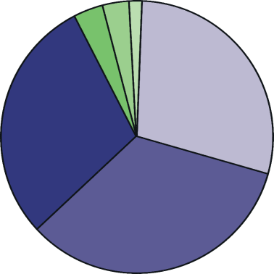
Who Causes Climate Change?
The 50 least developed countries are thought to have contributed 1% of the greenhouse gases that have caused global warming. The USA, the EU and China alone have contributed around 60%.
South America
Africa
Oceania
North America
Asia
Europe

Slide 39
Who Does Climate Change Affect?
In the long term, everyone will feel the effects of climate change. However, some people are currently more affected than others.
In most cases, the wealth of prosperous countries has come from activities which contribute to greenhouse gas emissions. This wealth allows these countries to protect themselves from the effects of climate change.
Poorer countries are less able to adapt to climate change and therefore suffer the most from its effects. They are also less able to develop because they need to focus on addressing the challenges caused by climate change.
The countries who have contributed the least to the climate crisis are the ones who are affected the most.
Is this fair?

Slide 40
Social Justice
Justice is the concept of fairness.
Social justice relates to fairness within a society.
The idea of social justice is that people should have equal access to wealth, health, opportunities and privileges within a society. All humans should have the right to a certain standard of living, including a healthy diet, access to clean water, shelter, clothing, education and healthcare.
The people most likely to be left behind by development are those that face inequalities.
Those that are most affected have intersecting inequalities. This means that they may face exclusion or discrimination because they fall into multiple disadvantaged groups, for example, Black women, disabled LGBTQ+ people or poor children.

Slide 41
Climate Justice
The impacts of climate change affect disadvantaged groups of people the most. The effect of climate change on these groups needs to be recognised and addressed.
Climate justice means looking at the climate crisis from the perspective of social justice. Solutions need to not only curb climate change; they need to protect and empower the most vulnerable groups of people too.
We have the responsibility to consider the most vulnerable when planning climate action. Remember, these groups of people contribute to climate change the least. This means putting the people and communities that are most vulnerable to the impact of climate change at the heart of development.
Climate solutions will not work if we do not address social justice issues. For example, if we do not address poverty, then unsustainable lifestyles will continue to damage ecosystems and we will fail to curb climate change.

Slide 42


Who Can Fix It?
Governments can make laws and policies that reduce the amount
of greenhouse gas emissions.
Businesses can change their processes to run more sustainably.
We can all make choices in our own lives that reduce our carbon footprint (the impact our actions and purchases have on climate change).
We can also use our voices to let businesses and governments know that we want them to act quickly to reduce their impact on climate change.

Slide 43
New Opportunities
The transition to a low-carbon economy in the years ahead brings with it many opportunities.
Transitioning to low-carbon economies will provide lots of opportunity for innovation.
There will be a need for people leaving education to do things differently, to come up with new ideas for products and technologies and to explore new conservation methods. These opportunities are exciting!
New job sectors will be created and new skills will be valued in the jobs market. In the future, you may be applying for jobs that don’t even exist yet!
Innovation is the process of turning an idea into a solution that solves a problem.

Slide 44

COP26
197 countries (parties) have signed up to the United Nations Framework Convention on Climate Change (UNFCCC).
The UNFCCC aims to prevent human activity from causing dangerous levels of climate change.
UNFCCC logo by UNclimatechange licensed under CC BY
Every time the member nations meet it is called a COP, which stands for Conference of the Parties. They look at the current state of the climate and discuss the actions they will take to address climate change.
This November will see the 26th of these meetings taking place, so you will hear the event being described as COP26 as well as the UN Climate Change Conference. It will be hosted by the UK in Glasgow.

Slide 45
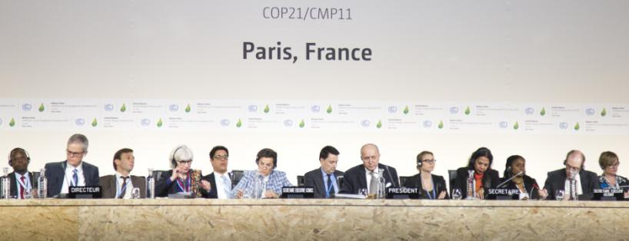
What Will Happen at COP26?
In 2015, at COP21 in Paris, the nations signed an agreement that set out an ambitious plan to tackle climate change. In the Paris Agreement, nations agreed to act together to restrict global temperature increases to 2°C and begin efforts to limit warming to 1.5°C.
To do this we will need to reach ‘net zero’ by 2050. This means that any carbon emissions will need to be balanced by removing carbon dioxide from the air.
Comité de Paris, COP21, by UNclimatechange licensed under CC BY

Slide 46
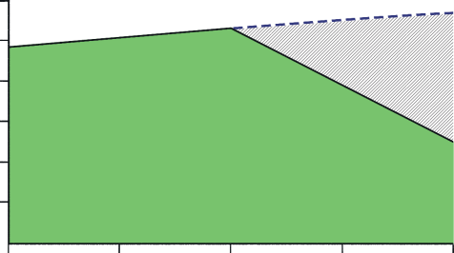
What Will Happen at COP26?
The Paris Agreement instructed governments to renew their commitment to lowering their emissions every five years, each time becoming more ambitious. New Nationally Determined Contributions (NDCs) are due to be set by countries at COP26, so it is an important moment for the planet.
Global carbon dioxide emissions continued to rise after The Paris Agreement, and are now 62% higher than they were in 1990.
Global net CO₂ emissions need to fall by 45% from 2010 levels by 2030 to limit global warming to 1.5°C.
60
expected carbon emissions based on current commitments
50
40
change needed
change needed
30
Global CO₂ Emissions (Gt)
2030 goal
20
10
2010
2015
2020
2025
2030

